Slide 1

PROJECT REPORT
GROUP 3 - T1.2109E0

Slide 2

The
website
PROJECT REPORT
GROUP 3 - T1.2109E0
Team Member:
Leader Đào Bùi Quang Hưng
Members: Nguyễn Hoài Thương
Nguyễn Ngọc Kim Ngân
Lã Bảo Minh
Instructor: Đào Ngọc Anh
TP.HCM - July 21, 2022

Slide 3
PROJECT REPORT
GROUP 3 - T1.2109E0
The
website
Team Member:
Leader Đào Bùi Quang Hưng
Members: Nguyễn Hoài Thương
Nguyễn Ngọc Kim Ngân
Lã Bảo Minh
Instructor: Đào Ngọc Anh
TP.HCM - July 21, 2022

Slide 4
Content
Introduction
- Actual requirements
- Requirements of the project
- Deployment diagram
Test result
Conclusion and development
Task list
OTAKOOL

Slide 5
Introduction
The internet has changed the way we work, socialize, create, and share information. Moreover, it fulfills customers’ demands through ease of access; buyers need not worry about traveling long distances to search for the items they want or to see if they are available.
We have decided to build an online shopping website to create the most convenient way for customers to purchase products related to Japanese entertainment culture. Launching the shopping website – www.otakool.com – is to overcome the obstacles that prevent otakus from getting the products they want.
OTAKOOL

Slide 6
Introduction - Actual requirements
Customer | Admin
- View products by category, latest product, promotion product. - Search product by name, tags, rating. - View product details and rate it. - Leave product reviews on the website. - Purchase product. - Create an account to become a member. - Feedback about the website. - View store’s news. - View store’s introduction. | Management: - Manage admin roles. - Manage customers, news, feedbacks, contacts and Q&A. - View products, orders and total revenue. Product Management: - Create a new product, modify the product. - Manage comments. - Create promotions for products, edit promotions. Order Management: - View orders, process orders, calculate revenue.
OTAKOOL

Slide 7
Introduction - Requirements of the project
Functions:
- Provide product information.
- Allows ordering online.
Function not implemented:
- No payment management, only delivery confirmation for revenue calculation.
OTAKOOL

Slide 8
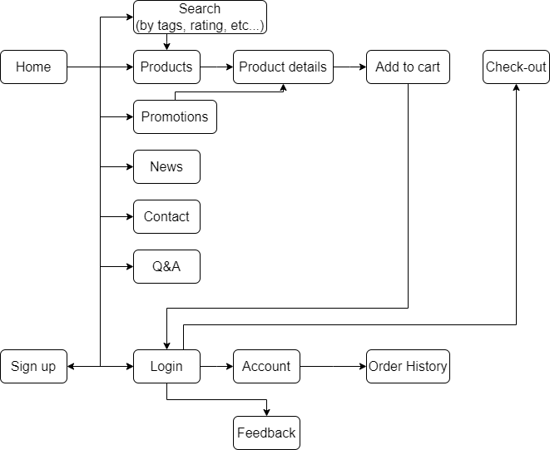
Introduction – Deployment Diagram
A. Customer Sitemap
OTAKOOL

Slide 9
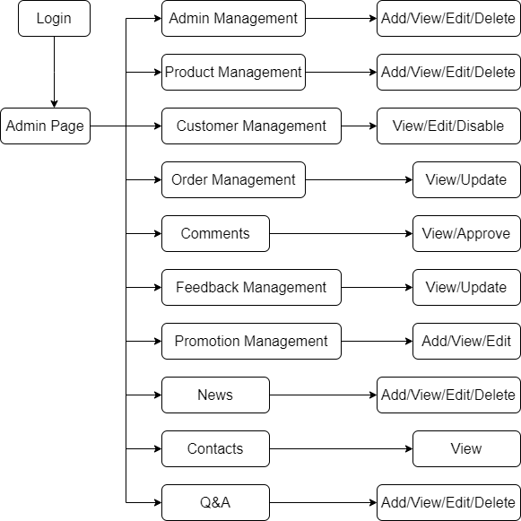
Introduction – Deployment Diagram
B. Admin Sitemap
OTAKOOL

Slide 10
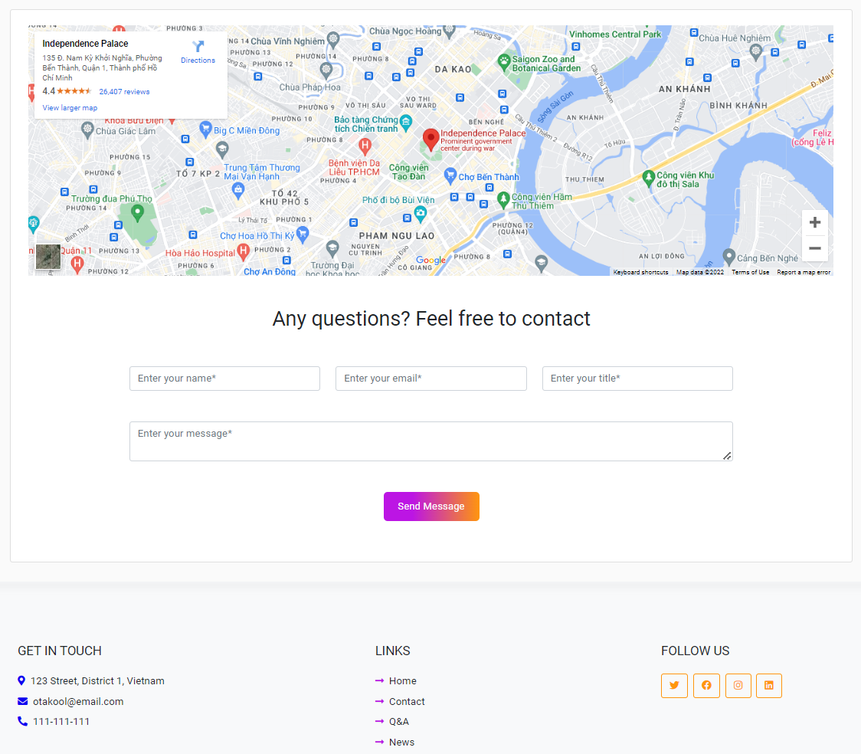
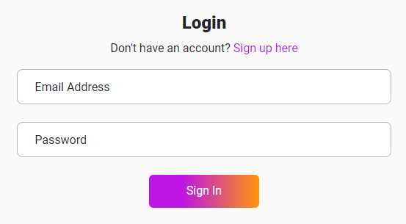
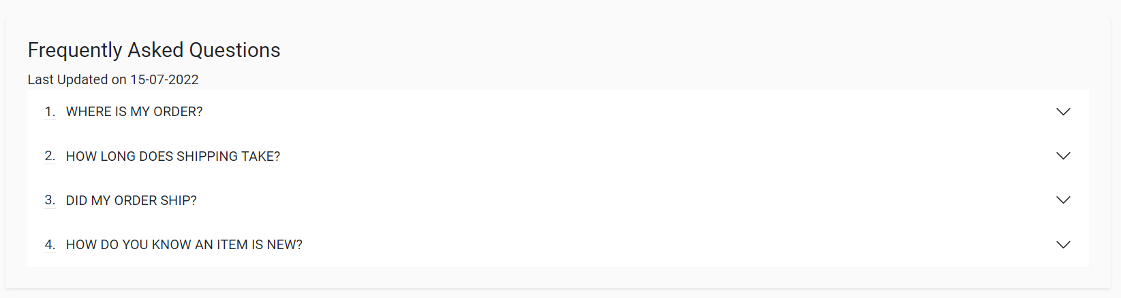
Test 1st
Front-end only:
OTAKOOL

Slide 11
Test 1st
Front-end only:
OTAKOOL

Slide 12
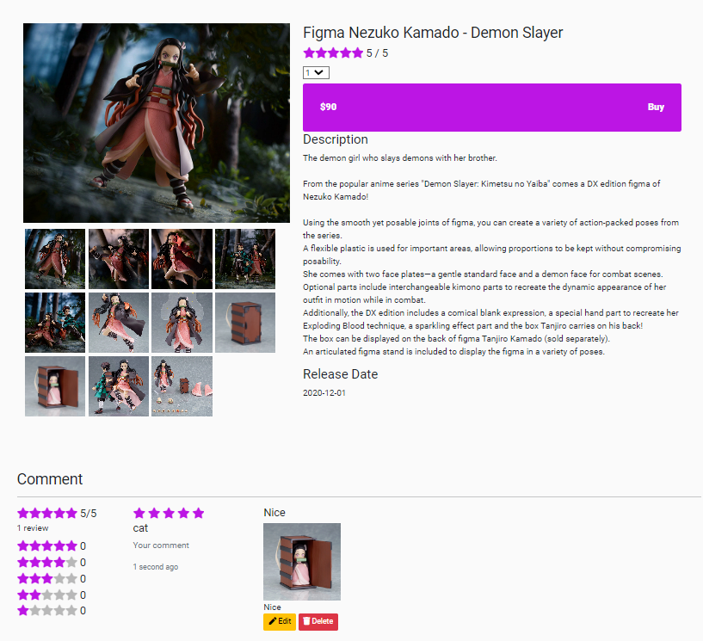
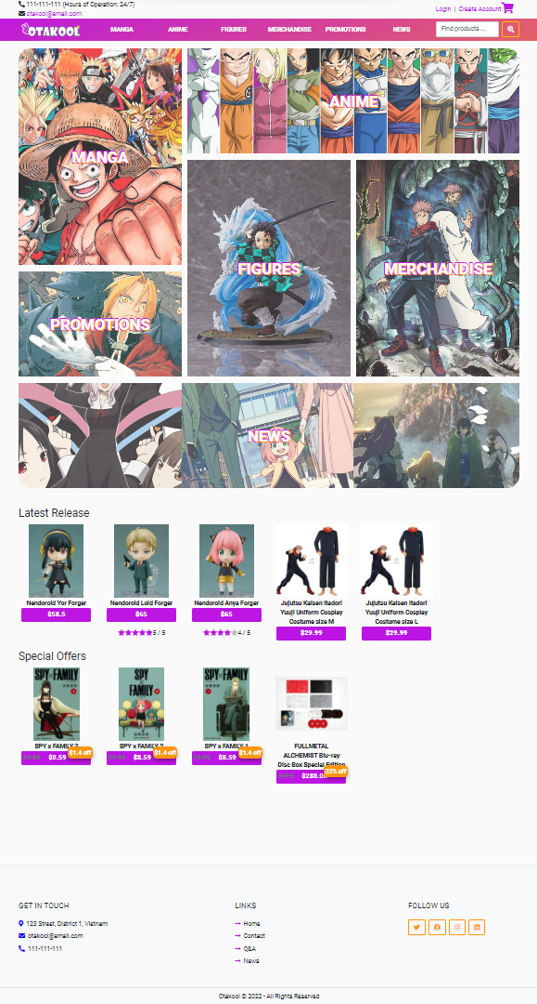
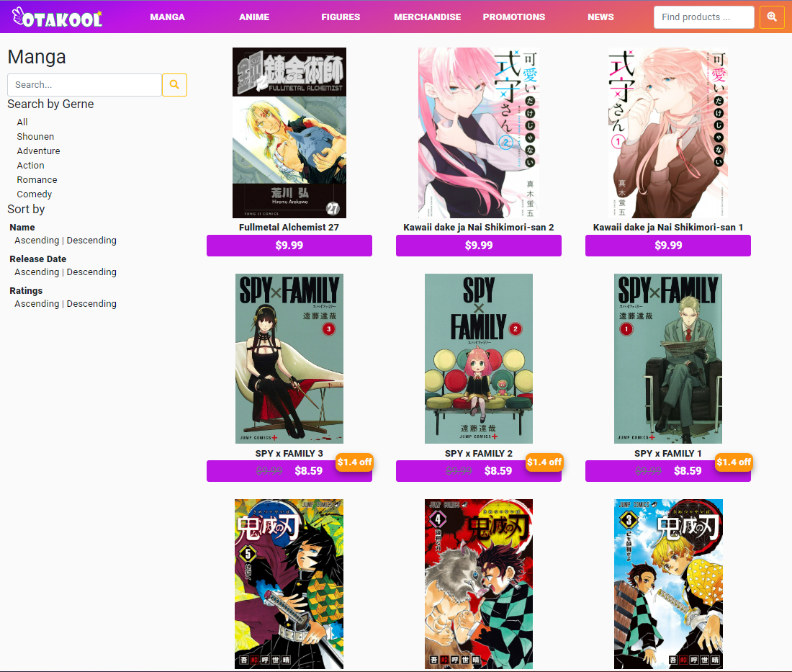
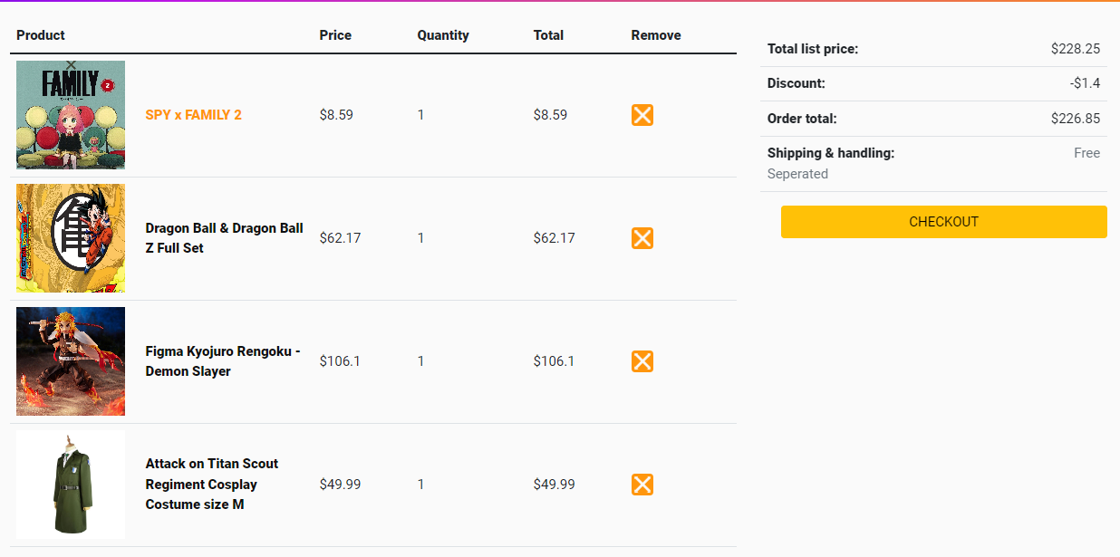
Test 2nd
Complete all interfaces and connecting to the database, with input and output functions
OTAKOOL

Slide 13
Test 2nd
Complete all interfaces and connecting to the database, with input and output functions
OTAKOOL

Slide 14
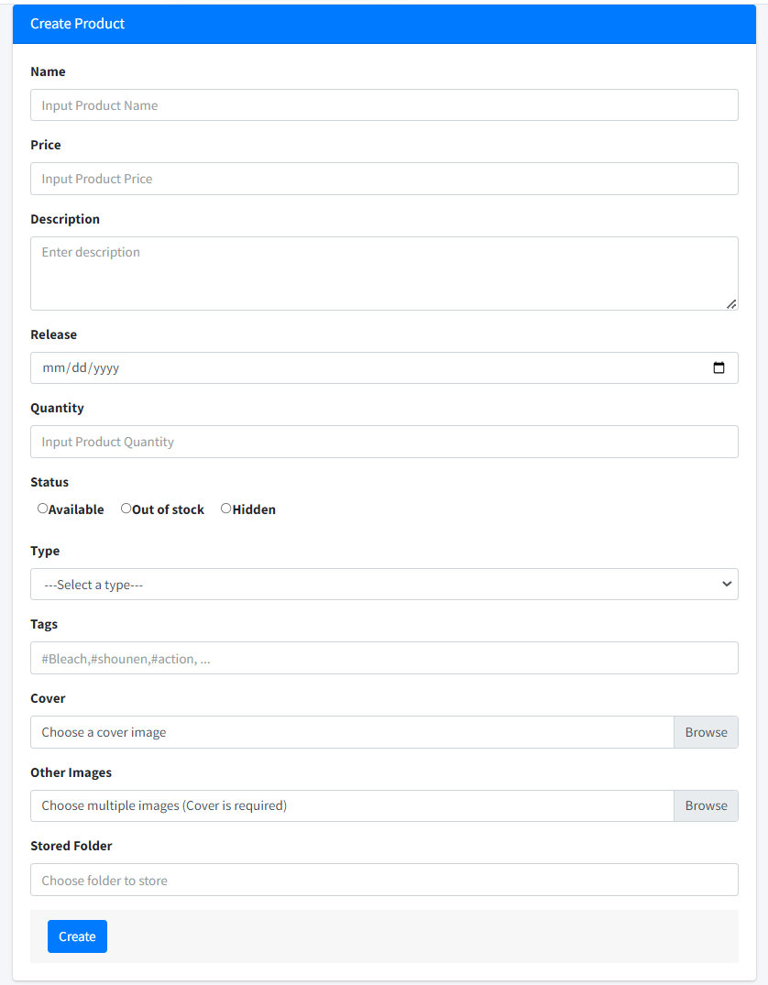
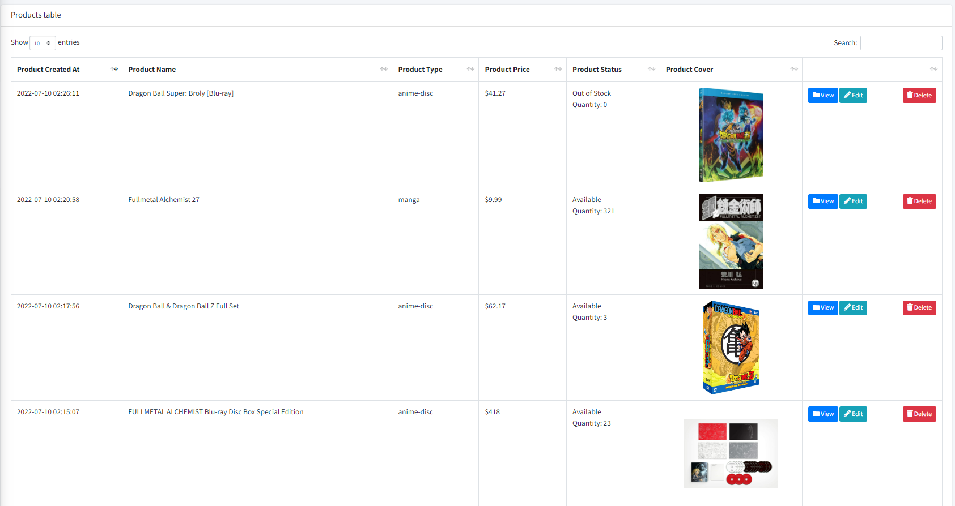
Test 2nd
Complete all interfaces and connecting to the database, with input and output functions
OTAKOOL

Slide 15
Test 2nd
Complete all interfaces and connecting to the database, with input and output functions
OTAKOOL

Slide 16
Conclusion
STRENGTHS User friendly design Relevant, unique content Quick sign up and check out process The functions meet most of the given requirements Runs stably, with few bugs | WEAKNESSES Poor mobile optimization Poor content and images
OPPORTUNITIES Review the knowledge learned Learn from each other Identify unknown points in dynamic website Can make the dynamic website | THREATS The time is just enough to develop the basic functions, will continue to improve the website
OTAKOOL

Slide 17
Development
Business Advisor.
Traffic.
Number of customers that have viewed the store during the selected time period.
Chat box for online consultation.
OTAKOOL

Slide 18
Task list
Review 1
Members |  | Date Preparation Of Activity Plan
No | Name | Description Task | Start Date | End Date | Status
1 | Đào Bùi Quang Hưng | All | 03/06/2022 | 08/06/2022 | Completed
2 | Nguyễn Hoài Thương | All | 03/06/2022 | 08/06/2022 | Completed
3 | Nguyễn Ngọc Kim Ngân | All | 03/06/2022 | 08/06/2022 | Completed
4 | Lã Bảo Minh | All | 03/06/2022 | 08/06/2022 | Completed
OTAKOOL

Slide 19
Task list
Review 2
Members |  | Date Preparation Of Activity Plan
No | Name | Description Task | Start Date | End Date | Status
1 | Đào Bùi Quang Hưng | All | 08/06/2022 | 15/06/2022 | Completed
2 | Nguyễn Hoài Thương | All | 08/06/2022 | 15/06/2022 | Completed
3 | Nguyễn Ngọc Kim Ngân | All | 08/06/2022 | 15/06/2022 | Completed
4 | Lã Bảo Minh | All | 08/06/2022 | 15/06/2022 | Completed
OTAKOOL

Slide 20
Task list
Review 3
Members |  | Date Preparation Of Activity Plan
No | Name | Description Task | Start Date | End Date | Status
1 | Đào Bùi Quang Hưng | FE: home page, header, product list, product details, comment BE: index page, product management, comments management | 15/06/2022 | 22/06/2022 | Completed
2 | Nguyễn Hoài Thương | FE: order, shopping cart, shopping history BE: order management | 15/06/2022 | 22/06/2022 | Completed
3 | Nguyễn Ngọc Kim Ngân | FE: footer, customer register, customer profile, Q&A, contact BE: admin management, customer management, Q&A management, contact management | 15/06/2022 | 22/06/2022 | Completed
4 | Lã Bảo Minh | FE: feedback, promotion, news BE: feedbacks management, promotions management, news management | 15/06/2022 | 22/06/2022 | Completed
OTAKOOL

Slide 21
Thank You
OTAKOOL

Slide 22
Thank You
OTAKOOL

Slide 23
Reference sources
Website: https://www.w3schools.com/
Course material: Dynamic Websites
OTAKOOL

